Slide 1
RENTAL SYSTEM
SDP1
GROUP NUMBER : 441

Slide 2

URBANDRIVES

Slide 3
TEAM MEMBERS
2000030270 – EDA MOKSHITA REDDY
2000030433 – KALLAM LASYA
2000031017 – TUBATI LAVANYA MANOGNA

Slide 4
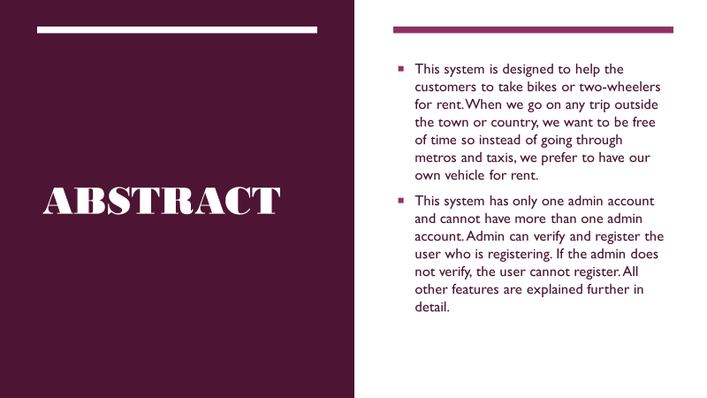
ABSTRACT

Slide 5
FUNCTIONAL REQUIREMENTS
The functional requirement of a bike system is that it does what it is meant for. A functional requirement describes what a software system should do, while non-functional requirements place constraints on how the system will do so. Functional requirements specify a function that a system or system component must be able to perform.
It can be documented in various ways. The most common ones are written descriptions in documents and use cases.
Few of its functional requirements are as given below: –
User data should be fed into the system: This system is doing that properly in the user entity.
Admin can add the users: Admin can verify and add the user, which is they are doing with this system.

Slide 6
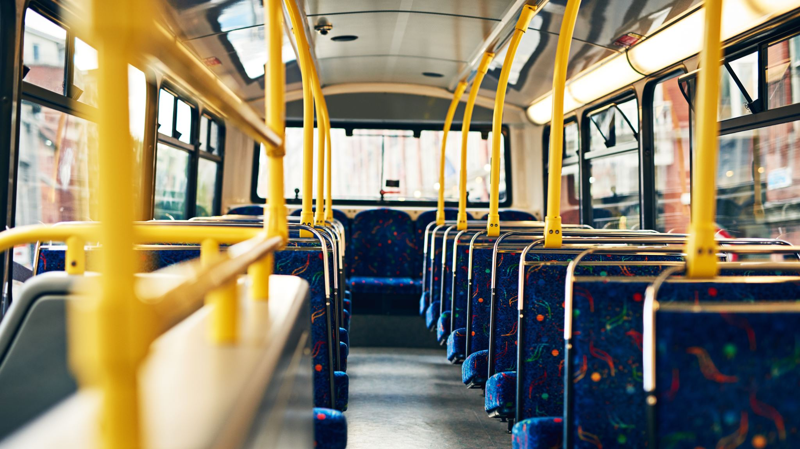
PROBLEMS IDENTIFIED
Waiting longer time for public transport can cause irritation.
People are feeling uncomfortable when traveling in buses.
Poor hygiene while travelling in public transport.
Irregular timings of buses.
People who came from other places can’t bring their own vehicle .So then can use rental bikes.

Slide 7
Modules of Bike Rental System
Our system has two main modules. One is the admin and the other is the user.
User: If the user is a customer, then he can see all the available bikes that he can take for rent.
Bikes: This is one of the most important modules. This module helps the customers to take bike for rent. The status of bikes can be updated as soon as it gets free or it gets booked so that no other customer tries to book the same bike. The information that is added to a bike is its model number, vehicle number.

Slide 8
MODULES
Login: After registration, one can log in to the system either as the event manager or the customer. The option to register either an employee or customer is given when the user is registering. The interface of this system depends upon the registration. If the user has registered as an employee, then it will have options like arranging all the things as asked by a customer for an event. For the customer, the interface includes the option to check all the available vehicles and their prices.
Admin: This module is present only for one account. That is, no one can register as an admin after one account is created. The admin account has all the privileges, to check about any particular bike details or customer details. To block any account, to update the status about any vehicle, to calculate the payment, to make changes into accounts of users ,etc.

Slide 9
MODULES
Payment: This module is present so that customers can easily pay the amount as the amount paid through this system goes to admin and then admin can make the payments to all the employess according to their work. The customer can pay the amount through net banking, debit card, or credit card.

Slide 10
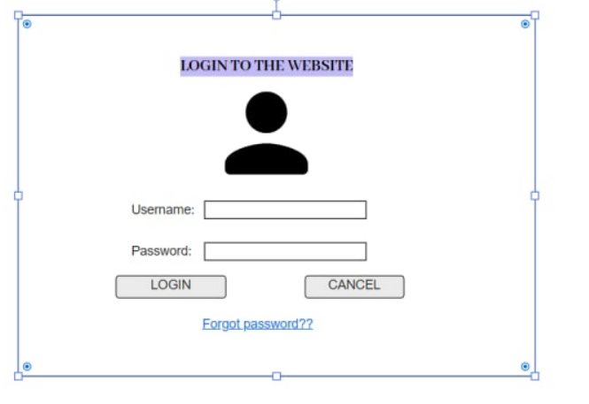
PROTOTYPE

Slide 11
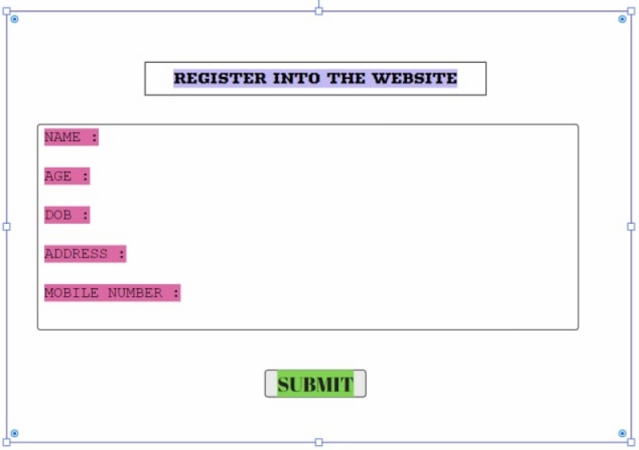
PROTOTYPE

Slide 12
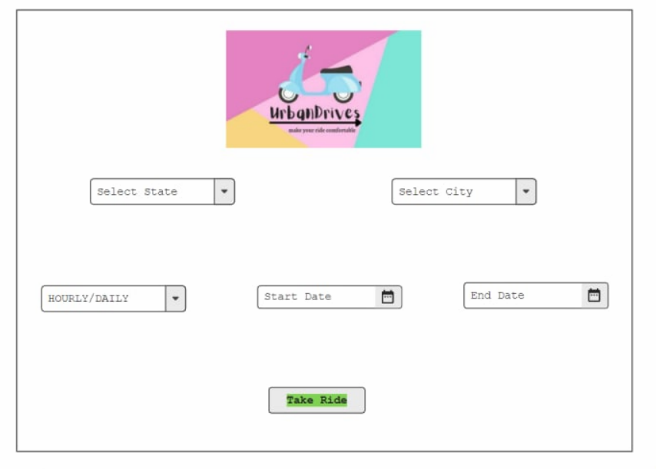
PROTOTYPE

Slide 13
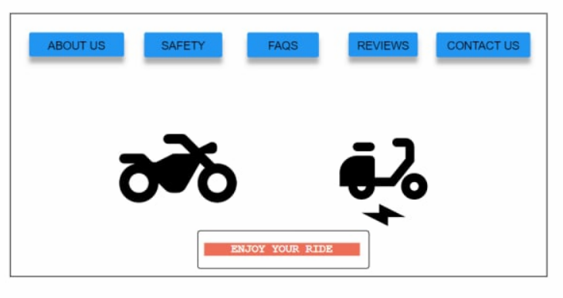
PROTOTYPE

Slide 14
USECASE FOR EACH MODULES
User Needs the Bike
To travel the places of short distances User needs bikes to cover the distance in less time.
user
user
bi
ke
needs

Slide 15
LOGIN PROCESS:
To rent the bike he should login to the system module. Thus this page is secured login page for customers in the website.
user
Logins/create
account

Slide 16
availability:
User checks the availability and prices of bikes which they need.
user
checks
availability

Slide 17
Rents:
User selects the bike and makes payments.
user
Selects the bike and makes payment
Through
Card/upi

Slide 18


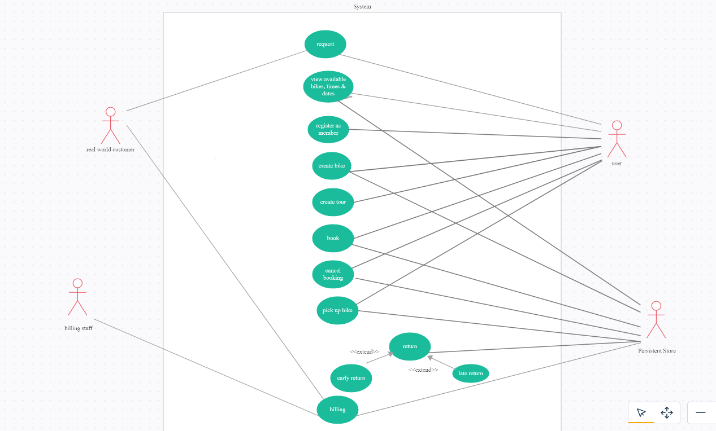


Slide 19
Login Form Using React.js

Slide 20
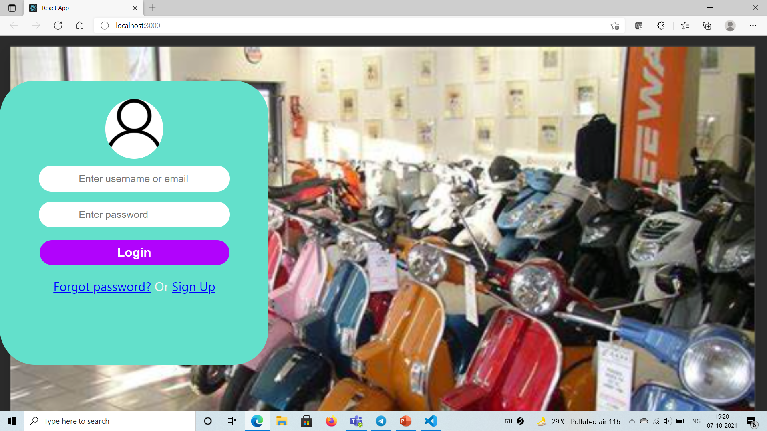

Slide 21
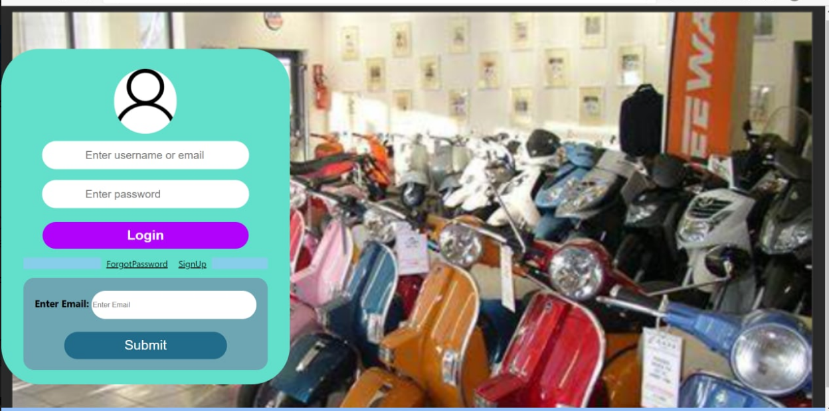

Slide 22
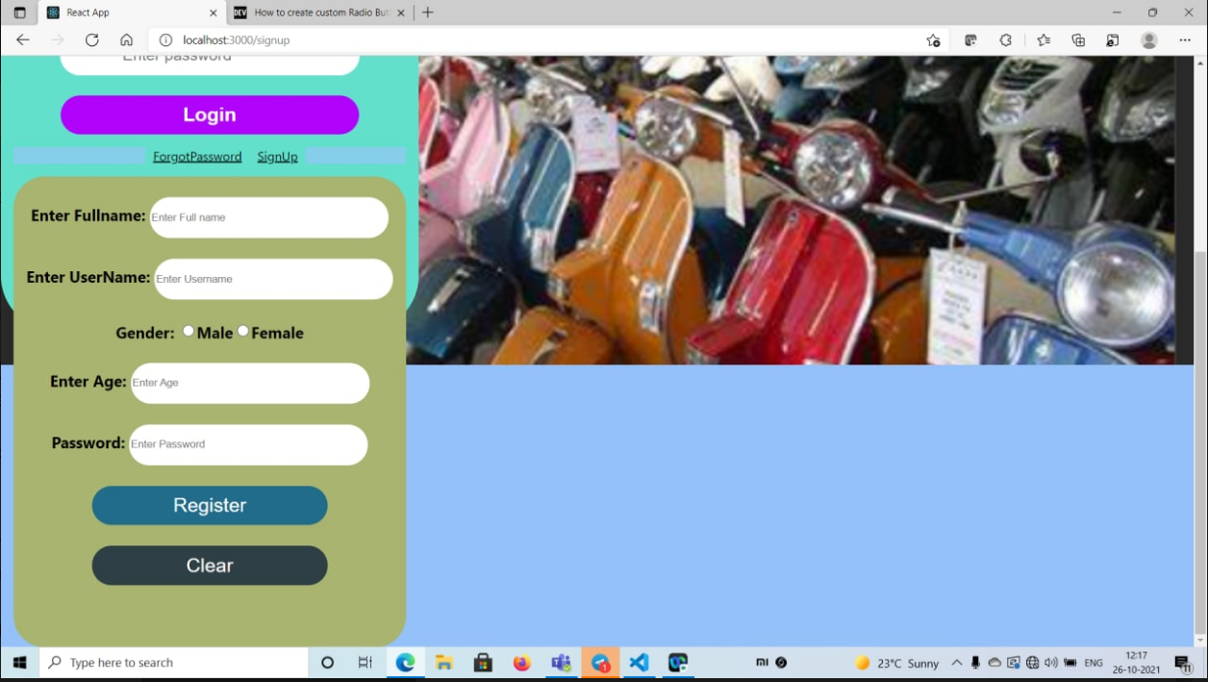

Slide 23



THANK YOU

